Slide 1


Version Control & Branching Strategies with GIT

Slide 2
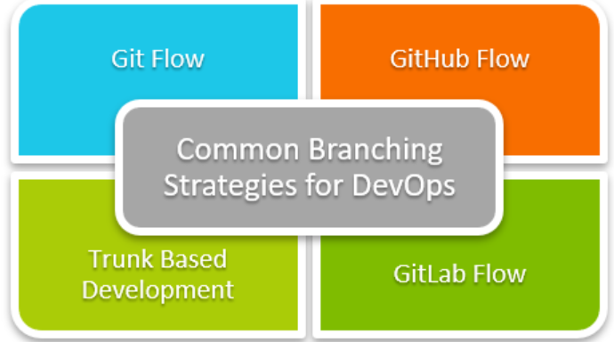
Overview
A Git branching strategy allows developers to collaborate on a project while also tracking changes and maintaining multiple versions of the codebase. There are several Git branching strategies available, each with its own set of advantages and disadvantages. The best strategy is determined by the project’s and team’s unique requirements. The popular Git branching strategies:
Trunk-Based Development
Feature Branching
Git Flow
Team Size | Recommended Strategies | Reasoning
Small team (1 - 5 members) | Trunk Based development, GitHub Flow | Simpler strategies minimize overhead and facilitate rapid integration.
Medium team (6 - 20 members) | Github Flow, Feature Branching | Structured branching to handle multiple features and tasks simultaneously.
Large team (20+) | Feature Branching, Git Flow | A structured approach to managing multiple parallel developments and releases.

Slide 3
Name | Lifecycle | Type | Protected | Environment Name | Required/optional | Data | prefixes
prod/master | Long-lived | Shared | Yes | DATAOPS_ENV_NAME_PROD | Required | Ingested | prod/
release | Long-lived | Shared | Yes | DATAOPS_ENV_NAME_RELEASE | Optional, basic level of maturity needed | Ingested | release/
dev | Long-lived | Shared | No | DATAOPS_ENV_NAME_DEV | Optional, basic level of maturity required | Cloned | dev/
feature | Short-lived | Individual | No | DATAOPS_PREFIX_FB_FEATURE_BRANCH_NAME | Should be used for all individual changes | Cloned | feature/
hotfix | Short-lived | Individual | No | DATAOPS_PREFIX_HOTFIX_BRANCH_NAME | Optional, basic level of maturity required | Cloned | hotfix/
docs | Long-lived | Shared | No | DATAOPS_PREFIX_DOCs_BRANCH_NAME | Optional, basic level of maturity required | Ingested | docs/
Master/Main/Prod: Includes main for production-ready code and develop for integration.
Feature : New features are developed in feature/* branches.
Release : When preparing for a release, a release/* branch is created for final testing and bug fixes.
Hotfix Branches: For urgent fixes, hotfix/* branches are created from main.

Slide 4
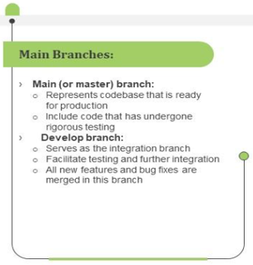
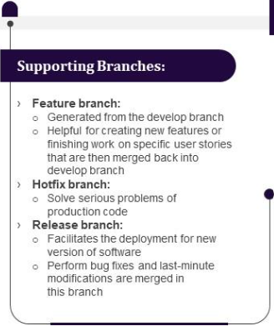

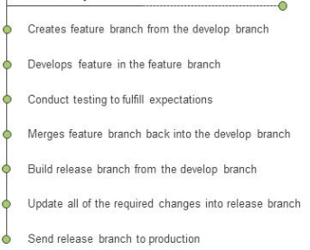
Detailed GitFlow Strategy branching and Workflow

Slide 5
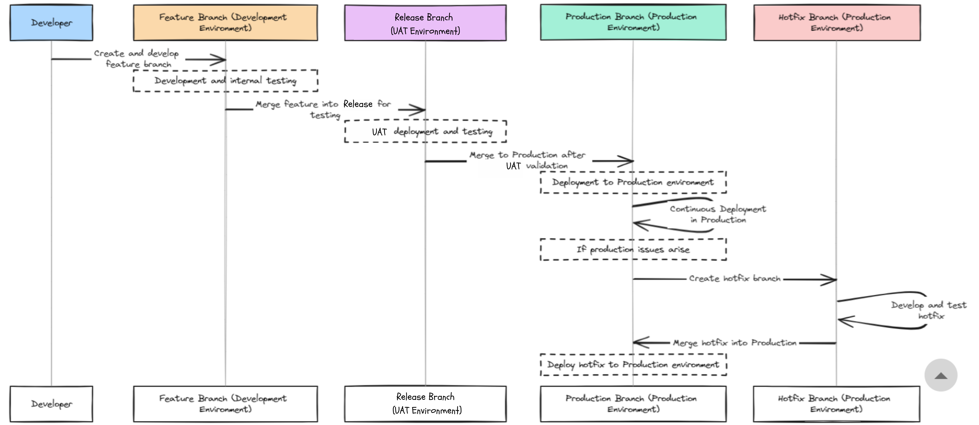

Slide 6
Thank You!

